Slide 1

DART PROGRAMMING
LANGUAGE ESSENTIALS
MODULE - 3
CHAPTER - 1

Slide 2
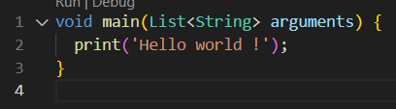
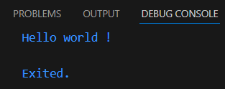
DART SYNTAX
Every Dart program starts with a main() function:
Example :
Output :

Slide 3
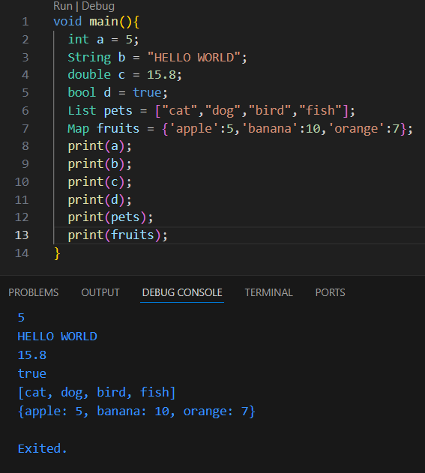
DATA TYPES
Int : Numbers.
Double : Decimal value.
String : Characters.
Booleans : Expression is true / false.
List : Object to store more than 1 value.
Maps : Object to store more than 1 value.

Slide 4
OPERATORS
ARITHMETIC
RELATIONAL
Operator | Description | Example | Result
+ | Addition | 5 + 2 | 7
- | Subtraction | 5 - 2 | 3
* | Multiplication | 5 * 2 | 10
/ | Division | 5 / 2 | 2.5
% | Modulus (Remainder) | 5 % 2 | 1
Operator | Description | Example | Result
== | Equal to | 5 == 5 | true
!= | Not equal to | 5 != 3 | true
> | Greater than | 5 > 3 | true
< | Less than | 5 < 3 | false
>= | Greater than or equal to | 5 >= 5 | true
<= | Less than or equal to | 3 <= 5 | true

Slide 5
LOGICAL
Operator | Description | Example | Result
&& | AND | (5>3)&&(4<6) | true
` | OR | `
! | NOT | !(5 > 3) | false
ASSIGNMENT
Operator | Example | Equivalent to
= | a = 10 | Assign value
+= | a += 2 | a = a + 2
-= | a -= 2 | a = a - 2
*= | a *= 2 | a = a * 2
/= | a /= 2 | a = a / 2
UNARY
Operator | Description | Example | Result
++ | Increment | a++ or ++a | Increases by 1
-- | Decrement | a-- or --a | Decreases by 1

Slide 6
CONTROL STATEMENT
CONDITIONAL STATEMENT
IF ELSE : Executes one block if the condition is true, otherwise another block.
NESTED IF : An if statement inside another if.
SWITCH CASE : When you need to compare one variable against many values.
ITERATION STATEMENT
FOR LOOP : To execute a block of code repeatedly for a specific number of times.
WHILE LOOP : To repeat a block of code as long as a specified condition remains true.
DO WHILE : To execute a block of code at least once, and then continue looping while the condition is true.
JUMP STATEMENT
BREAK : To immediately exit a loop or switch statement.
CONTINUE : To skip the current iteration of a loop and move to the next one.

Slide 7
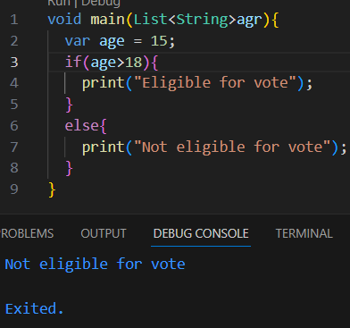
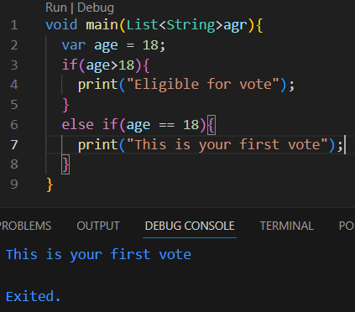
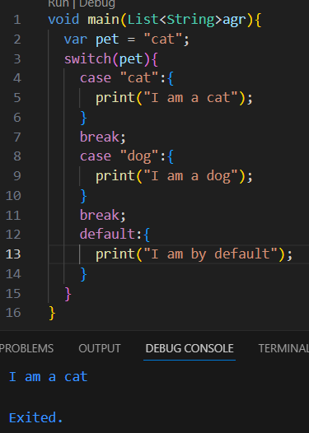
CONDITIONAL STATEMENT
IF ELSE
NESTED IF
SWITCH CASE

Slide 8
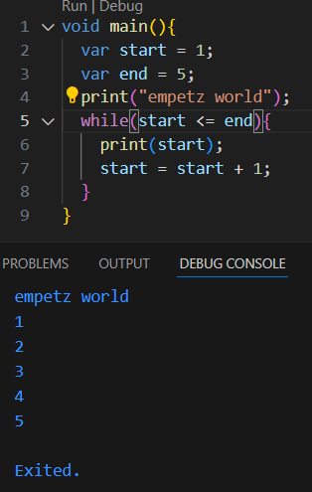
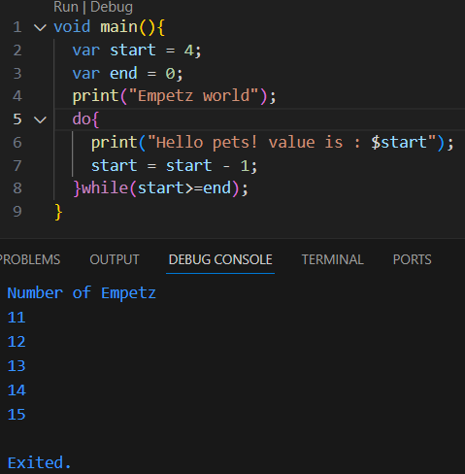
ITERATION STATEMENT
WHILE
DO WHILE

Slide 9
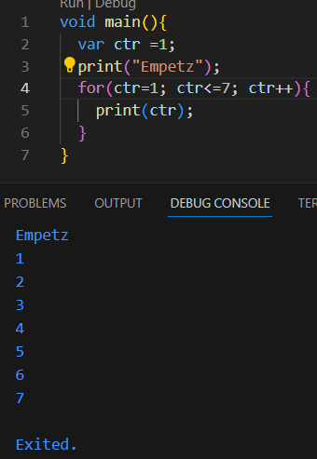
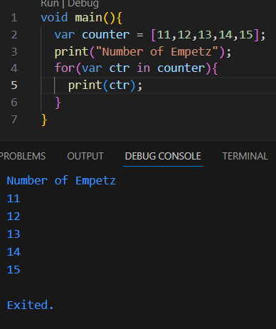
FOR
FOR IN

Slide 10
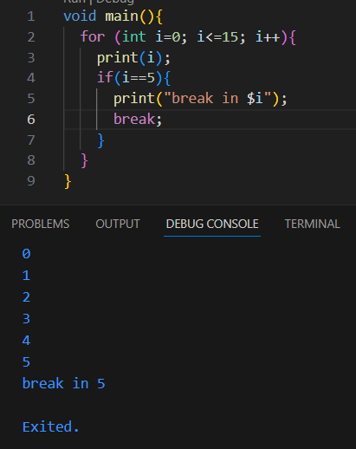
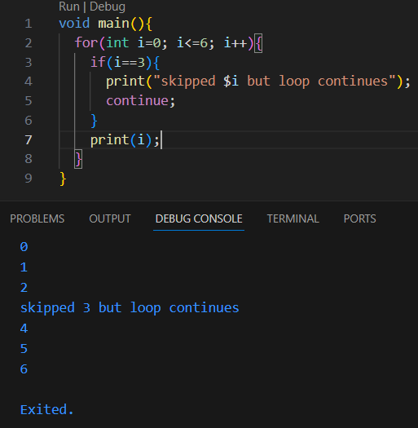
JUMP STATEMENT
BREAK
CONTINUE

Slide 11
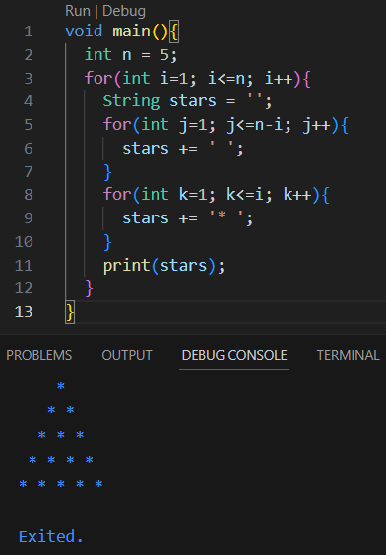
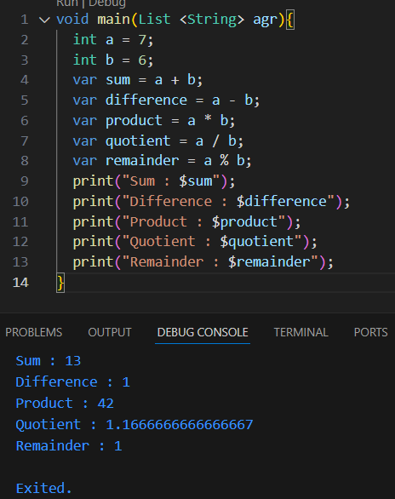
EXERCISE 1
EXERCISE 2

Slide 12
THANK YOU !

